Slide 1
COIS1020H: Programming for Computing Systems
Chapter 5
Looping

Slide 2
Loops
Loop
  Structure that allows repeated execution of a block of statements
Loop body
  Block of statements within a looping structure
C# types of loops
  while loop
  for loop
  do loop (or do-while loop)

Slide 3

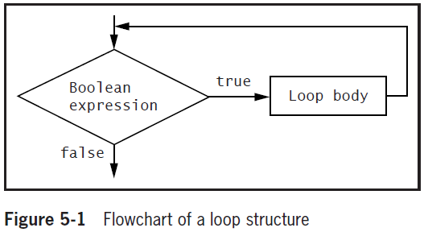
while Loop

Slide 4
Using the while Loop
while loop
  Used to execute a body of statements continuously as long as some condition continues to be true
  Pretest loop
Infinite loop
  A loop that never ends
Making a while loop end correctly
  Initialize the loop control variable
  Test the control variable in the while expression
  Alter the value of the control variable

Slide 5
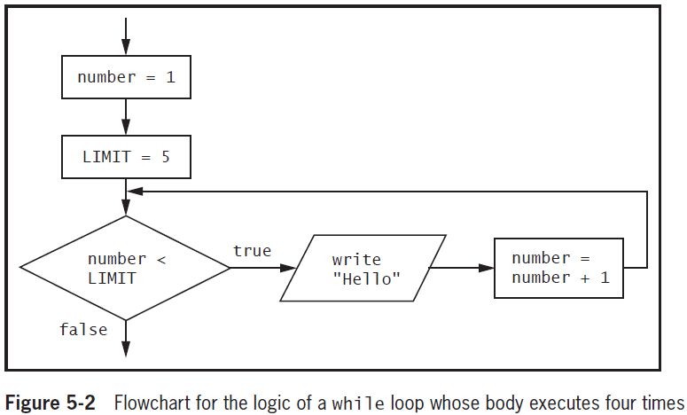
Using the while Loop (cont'd.)

Slide 6
Using the while Loop (cont'd.)
using System;
public static class FourHellos
{
public static void Main()
{
int number = 1;
const int LIMIT = 5;
while (number < LIMIT)
{
Console.WriteLine("Hello");
number = number + 1;
}
}
}
Hello
Hello
Hello
Hello

Slide 7
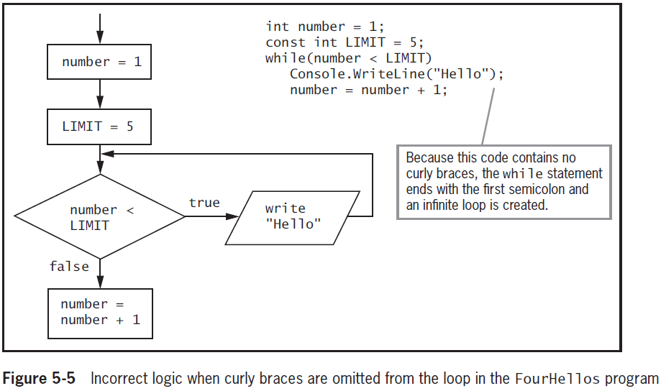
Using the while Loop (cont'd.)

Slide 8
Using the while Loop (cont'd.)
Empty body
  Body with no statements in it
Alter the control variable by:
  Incrementing, or adding to it
  Decrementing it
Definite loop or counted loop
  Loop for which the number of iterations is predetermined
Indefinite loop
  Value of a loop control variable is not altered by arithmetic, but instead, is altered by user input

Slide 9
Using the while Loop (cont'd.)
using System;
public static class LoopingBankBal
{
public static void Main()
{
double bankBal = 1000;
const double INT_RATE = 0.04;
char response;
Console.Write("Do you want to see your balance? Y or N ...");
response = Convert.ToChar(Console.ReadLine());
while (response == 'Y')
{
Console.WriteLine("Bank balance is {0:C}", bankBal);
bankBal = bankBal + bankBal * INT_RATE;
Console.Write("Do you want to see next year’s balance? Y or N ...");
response = Convert.ToChar(Console.ReadLine());
}
Console.WriteLine("Have a nice day!");
Console.ReadLine();
}
}
Do you want to see your balance? Y or N …Y
Bank balance is $1,000.00
Do you want to see next year’s balance? Y or N …Y
Bank balance is $1,040.00
Do you want to see next year’s balance? Y or N …N
Have a nice day!

Slide 10
Using the for Loop
for loop
  Shorthand way to create definite loops
Sections of the loop
  Control variable initialization
  Control variable testing
  Control variable updating
Other tasks
  Initialize more than one variable
  Declare a new variable
  Perform more than one test

Slide 11
Using the for Loop (cont'd.)
Other tasks (cont'd.)
  Decrement or perform some other task at the end of the loop’s execution
  Perform multiple tasks at the end of the loop’s execution
  Leave one or more portions of the for expression empty
    Be careful with for(;;)
      It is an intentional infinite loop (POOR STYLE)
  Also a pretest loop

Slide 12
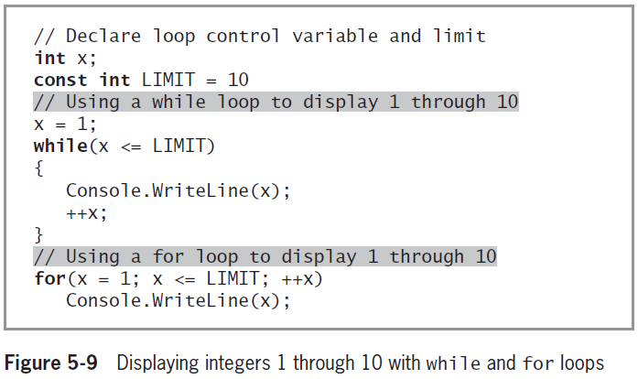
Using the for Loop (cont'd.)

Slide 13
Computing an Average (For Loop)
using System;
public static class ComputeAverageFor
{
public static void Main()
{
int numMarks, mark, total = 0;
double averageMark;
Console.Write("Enter the number of marks (+ve) => ");
numMarks = Convert.ToInt32(Console.ReadLine());
for (int i = 0; i < numMarks; ++i)
{
Console.Write("Enter a mark => ");
mark = Convert.ToInt32(Console.ReadLine());
total = total + mark;
}
Definite Loop

Slide 14
For Loop Average (Con’t)
if (numMarks > 0)
averageMark = total / (1.0 * numMarks);
else
averageMark = 0.0;
Console.WriteLine("The average of {0} marks is {1:F}", numMarks,
averageMark);
Console.ReadLine();
}
}
Enter the number of marks (+ve) => 3
Enter a mark => 87
Enter a mark => 64
Enter a mark => 78
The average of 3 marks is 76.33

Slide 15
Computing an Average (While Loop)
using System;
public static class ComputeAverageWhile
{
public static void Main()
{
int numMarks = 0, mark, total = 0;
double averageMark;
Console.Write("Enter a mark or -ve number to quit => ");
mark = Convert.ToInt32(Console.ReadLine());
while(mark >= 0)
{
total = total + mark;
numMarks++;
Console.Write("Enter a mark or -ve number to quit => ");
mark = Convert.ToInt32(Console.ReadLine());
}
Indefinite Loop
Sentinnel value
Sentinnel Value

Slide 16
While Loop Average (Con’t)
if (numMarks > 0)
averageMark = total / (1.0 * numMarks);
else
averageMark = 0.0;
Console.WriteLine("The average of {0} marks is {1:F}",
numMarks, averageMark);
Console.ReadLine();
}
}
Enter a mark or -ve number to quit => 84
Enter a mark or -ve number to quit => 67
Enter a mark or -ve number to quit => 78
Enter a mark or -ve number to quit => -1
The average of 3 marks is 76.33

Slide 17
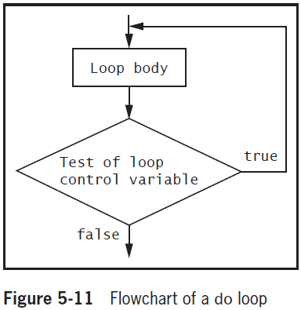
Using the do Loop
do loop
  Checks at the bottom of the loop after one repetition has occurred (posttest loop)
Convenient when you know you want to perform some task at least one time

Slide 18
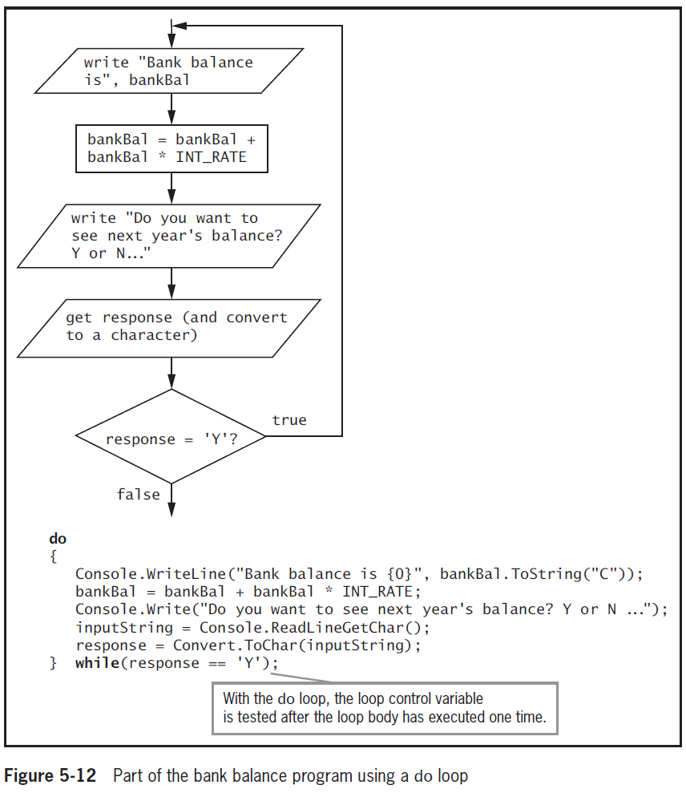
Using the do Loop (cont'd.)

Slide 19
Using the do Loop (cont’d)
Applications of do loop
  Validating data
  Console.Write(“Enter a number between 1 and 10”);
  num = Convert.ToInt32(Console.ReadLine());
  becomes
  do
  {
  Console.Write(“Enter a number between 1 and 10”);
  num = Convert.ToInt32(Console.ReadLine());
  } while (num < 1 || num > 10);

Slide 20
Validating Input Example
using System;
public static class ComputeAverageWhileValidateData
{
public static void Main()
{
int numMarks=0, mark, total = 0;
double averageMark;
// Input and validate a mark
do
{
Console.Write("Enter a mark or -1 to quit => ");
mark = Convert.ToInt32(Console.ReadLine());
} while (mark < -1 || mark > 100);

Slide 21
Validating Input Example (cond’t)
// loop while not seeing the sentinel value
while (mark >= 0)
{
total = total + mark;
numMarks++;
// Input and validate the next mark
do
{
Console.Write("Enter a mark or -ve number to quit => ");
mark = Convert.ToInt32(Console.ReadLine());
} while (mark < -1 || mark > 100);
}

Slide 22
Validating Input Example (cond’t)
// make sure the numMarks is not 0
if (numMarks > 0)
averageMark = total / (1.0 * numMarks);
else
averageMark = 0.0;
Console.WriteLine("The average of {0} marks is {1:F}",
numMarks, averageMark);
Console.ReadLine();
}
}

Slide 23
Using Nested Loops
When loops are nested, each pair contains an inner loop and an outer loop
  The inner loop must be entirely contained within the outer loop
  Loops can never overlap

Slide 24
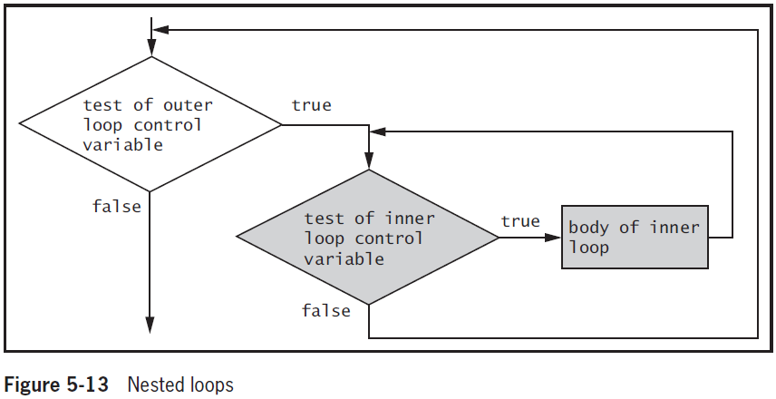
Using Nested Loops (cont'd.)

Slide 25
Starting bank balance is $1,000.00
Interest Rate: 4.00%
Starting bank balance is $1,000.00
After year 1, bank balance is $1,040.00
After year 2, bank balance is $1,081.60
After year 3, bank balance is $1,124.86
After year 4, bank balance is $1,169.86
After year 5, bank balance is $1,216.65
Interest Rate: 6.00%
Starting bank balance is $1,000.00
After year 1, bank balance is $1,060.00
After year 2, bank balance is $1,123.60
After year 3, bank balance is $1,191.02
After year 4, bank balance is $1,262.48
After year 5, bank balance is $1,338.23
Interest Rate: 8.00%
Starting bank balance is $1,000.00
After year 1, bank balance is $1,080.00
After year 2, bank balance is $1,166.40
After year 3, bank balance is $1,259.71
After year 4, bank balance is $1,360.49
After year 5, bank balance is $1,469.33
using System;
public static class LoopingBankBal2
{
public static void Main()
{
double bankBal;
double rate;
int year;
const double START_BAL = 1000;
const double START_INT = 0.04;
const double INT_INCREASE = 0.02;
const double LAST_INT = 0.08;
const int END_YEAR = 5;
for (rate = START_INT; rate <= LAST_INT; rate += INT_INCREASE)
{
bankBal = START_BAL;
Console.WriteLine("Starting bank balance is {0:C}", bankBal);
Console.WriteLine("Interest Rate: {0:P}", rate);
for (year = 1; year <= END_YEAR; ++year)
{
bankBal = bankBal + bankBal * rate;
Console.WriteLine(" After year {0}, bank balance is {1:C}", year, bankBal);
}
}
Console.ReadLine();
}
}

Slide 26
Accumulating Totals
Totals are accumulated
  Gathered together and added into a final sum
    By processing individual records one at a time in a loop
    sum = sum + mark; // or
    sum += mark;
Garbage
  Unknown value (initial value of sum)
  C# compiler helps to prevent seeing an incorrect total
    By requiring you to provide a starting value
  C# will not use the garbage value that happens to be stored at an uninitialized memory location

Slide 27
Accumulating Totals
Use a sentinel value to signal the end of data input
  A sentinel value is a value of the same data type but not a legal data value
using System;
public static class TotalPurchase
{
public static void Main()
{
double purchase;
double total = 0;
const double QUIT = 0;
Console.WriteLine("Enter purchase amount ");
purchase = Convert.ToDouble(Console.ReadLine());
while (purchase != QUIT)
{
total += purchase;
Console.WriteLine("Enter next purchase amount, or 0 to quit ");
purchase = Convert.ToDouble(Console.ReadLine());
}
Console.WriteLine("Your total is {0:C}", total);
Console.ReadLine();
}
}
Enter purchase amount
14.50
Enter purchase amount, or 0 to quit
5.19
Enter purchase amount, or 0 to quit
3.04
Enter purchase amount, or 0 to quit
0
Your total is $22.73

Slide 28
Improving Loop Performance
Make sure the loop does not include unnecessary operations or statements
Example
  A loop should execute while x is less than the sum of two integers, a and b
Initial solution
  while (x < a + b)
  // loop body
Better solution
  int sum = a + b;
  while (x < sum)
  // loop body

Slide 29
Summary
A loop is a structure that allows repeated execution of a block of statements
Use a while loop to execute a body of statements continuously while some condition continues to be true
When using a for statement, you can indicate in one place:
  Starting value for the loop control variable
  Test condition that controls loop entry
  Expression that alters the loop control variable

Slide 30
Summary (cont'd.)
The do loop checks the bottom of the loop after one repetition has occurred
You can nest any combination of loops to achieve desired results
In computer programs, totals frequently are accumulated
Improve loop performance by making sure loop does not include unnecessary operations

